Slide 1

Riddles of the Day
8s
Story Time
Word Puzzle
Magical Room
2 Fathers 2 Sons
Code Breaker
Word
Sticks
Global Logistics
Weight
Weird Words
Captain
Invisible Apple
Spot the Error
Who Am I
Escape Route
Train Puzzle
Brain Teaser
How To

Slide 2
Menu
8s
How can you add eight eights to get one thousand?
Answer: add 888 + 88 + 8 + 8 + 8 = 1000 !!

Slide 3
Menu
Two Fathers Two Sons
Two fathers and two sons sat down to eat eggs for breakfast. They ate exactly three eggs, each person had an egg. How is this possible?
Answer: One of the fathers is also a grandfather. Therefore the other father is both a son and a father to the grandson. In other words, the one father is both a father and a son

Slide 4
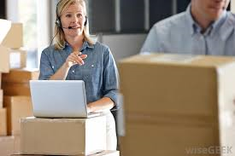
Menu
Global Logistics
The Logistics Manager knows she can place eight large boxes or ten small boxes in a carton for shipping from China to the UK. In one shipment she sent 96 boxes. If there are more large boxes than small boxes how many cartons did she ship?
Answer: 11 cartons in total
7 large boxes 7 x 8 = 56
4 small boxes 4 x 10 = 40

Slide 5
Menu
Invisible Apple
There are 20 people in an empty, square room. Each person has full sight of the entire room and everyone in it without turning his head or body, or moving in any way (other than the eyes). Where can you place an apple so that all but one person can see it?
Answer: Put the apple on one person’s head

Slide 6
Menu
Train Puzzle
If an electric train is travelling south which way is the smoke going
There is no smoke as the train is electric

Slide 7
Menu
Finish the story ……
It was a sunny day as I walked slowly up the hill feeling grateful for the sun upon my face. It was a hill I had climbed so many times before but on this particular day on reaching the precipice that I knew so well I suddenly ………

Slide 8
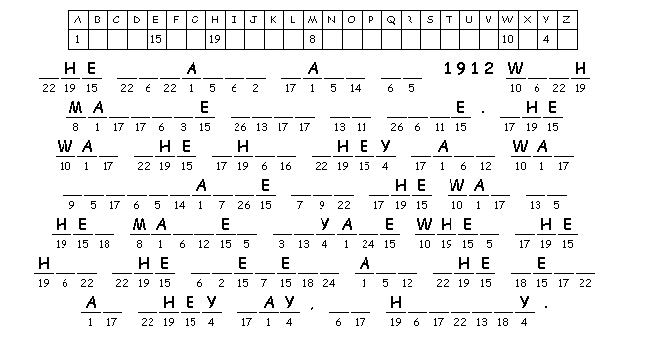
Menu

Slide 9
Menu
How to Guess the Weight of Someone
A boy was at a carnival and went to a booth where a man said to the boy, "If I write your exact weight on this piece of paper then you have to give me £50, but if I cannot, I will pay you £50." The boy looked around and saw no scale so he agrees, thinking no matter what the carny writes he'll just say he weighs more or less. In the end the boy ended up paying the man £50. How did the man win the bet?
The man did exactly as he said he would and wrote "your exact weight" on the paper

Slide 10
Menu
Spot the Error!
separate | definate | truthfull | usefull | excellent
excelent | definite | hopeing | hopeful | babeys
ladeys | belive | believe | sence | sensable
necesary | beautiful | decieve | receive | reachible
grateful | absense | cieling | nonsence | ladies

Slide 11
Menu
Brain Teaser
What appears once in a minute, twice in a moment, but never in a thousand years?
M

Slide 12
Menu
Word Puzzle
I can be cracked, I can be made. I can be told, I can be played. What am I?
A Joke

Slide 13
Menu
Word
There is a common English word that is nine letters long. Each time you remove a letter from it, it still remains an English word - from nine letters right down to a single letter. What is the original word, and what are the words that it becomes after removing one letter at a time?
The base word is Startling - starting - staring - string - sting - sing - sin - in - I

Slide 14
Menu
Can you define:
Collywobbles -
Ignoramus -
Braggart -
Homily -
Disingenuous -
Feeling fear
Ignorant person
A person who brags
Sermon
Not sincere

Slide 15
Menu
Who Am I?
I never was but always will be. No one ever saw me but everyone knows I exist. I give people the motivation to better themselves everyday. What am I?
Tomorrow

Slide 16
Menu
Equation Maker
How can you physically stand behind your friend as he physically stands behind you?
Stand Back to Back

Slide 17
Menu
Magical Room
You're in a magical bathroom with no windows and the only way things can get in and out is by an open door. You decide to have a bath so you turn on the tap, you shut the door and the handle breaks so you can't open it, you then turn off the tap and the knob breaks so water keeps coming. How do you save yourself from drowning?
Pull Out the Plug

Slide 18
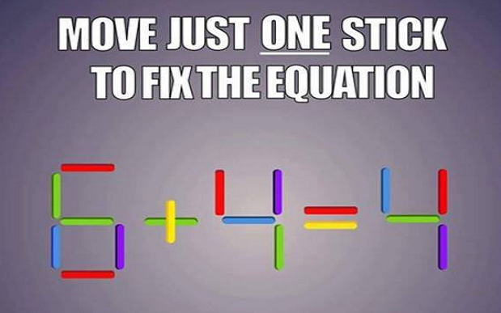
Menu
Matchsticks

Slide 19
Menu
What is the Captain’s Name
I was standing by a railing,
watching a ship a sailing.
What is the Captain’s name.
If you don’t know his name,
It’s you to blame.
What is the Captain’s name.
What

Slide 20
Menu
Escape Route
A man is trapped in a room with only two possible exits. Through the first door is a room with an enormous magnifying glass causing the blazing hot sun to instantly burn anything that enters. Through the second door there is a fire-breathing dragon. How does the man escape?
Leave through the first door at night when the sun is down.

Slide 21
Menu

